Slide 1
Tourism Analysis and Prediction
A Final Year Major Project Presentation
on
SUPERVISOR
Er. Ashok G.M
Presented By:
Sachin Bhattarai (39588)
Sakar Mainali (39592)
Sandesh Sharan Poudel (39595)
Utsab Pokharel (39605)
Date:2076/04/29

Slide 2
Overview
Introduction
Objectives
Scope
Use Case Diagram
System Overview
DFD
Methodology
Conclusion
Limitation
Future Enhancement
Reference

Slide 3
Introduction
Tourism represents a major area of interest, not just because of its size in terms of the enormous number of visitors , but also because of its enormous impact on national economies and people’s lives
There needs an application of Data Science that unifies statistics, data analysis, machine learning and their related methods to understand and analyze actual phenomena with data
The purposed project is a simple application of Data Science with a quest to add some insights from data in tourism sector of Nepal

Slide 4
Objectives
To build a website and provide visualization on topics of tourist arrivals
To predict the percentage of tourist arriving at particular location based on available facility
To predict annual foreign income and monthly tourist arrival

Slide 5
Scope
Government bodies can use the insights to set marketing goals,explore potential markets,formulate necessary plans and policies related to travel and tourism
Managers of travel and tour agencies can use the insights to determine operational requirements such as staffing and capacity, ,study project feasibility such as the viability to build a new hotel

Slide 6
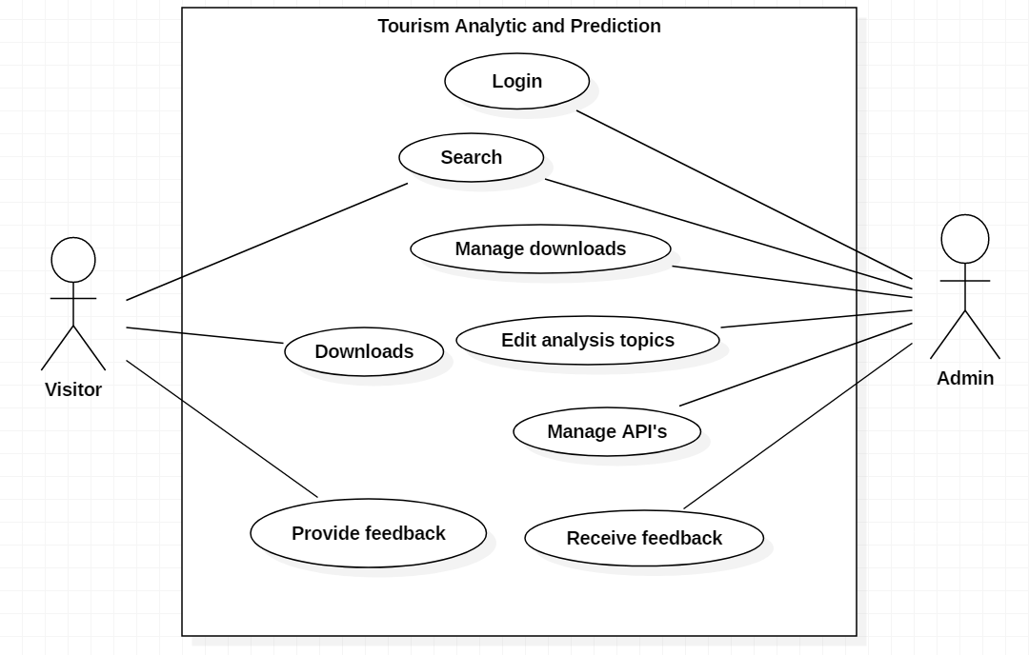
Use case

Slide 7
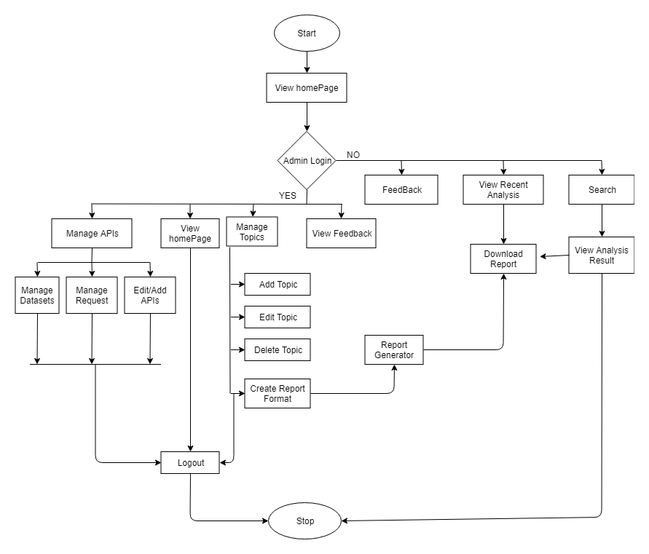
System overview

Slide 8
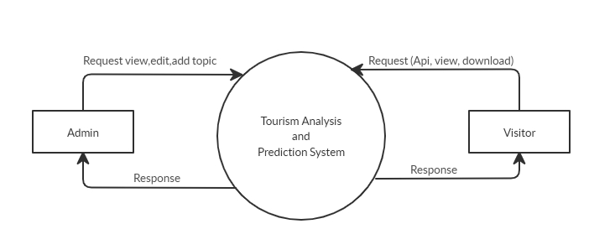
DFD Level-0

Slide 9
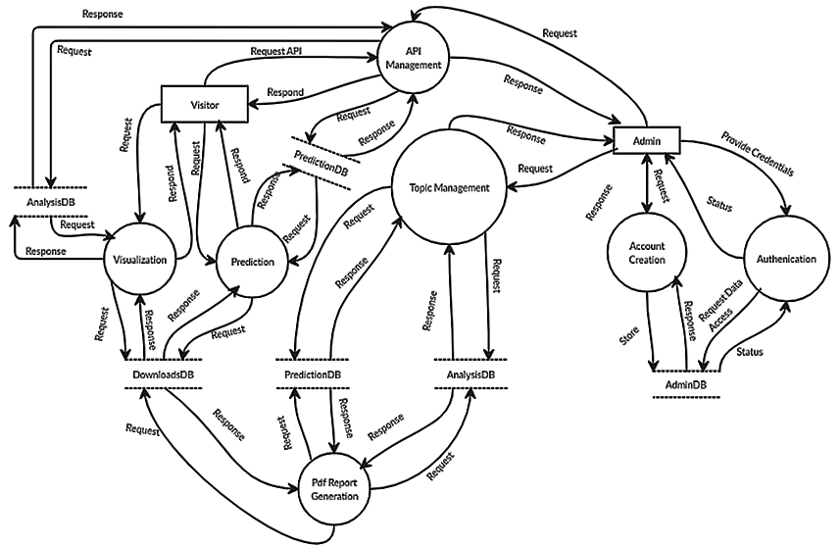
DFD Level-1

Slide 10
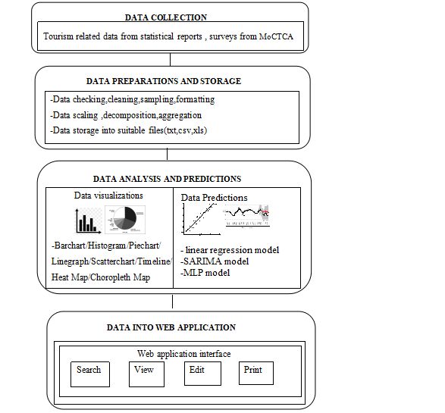
Methodology
DATA SOURCES:
1.Government of Nepal(MoCTCA), Tourism statistics reports
2.World Travel & Tourism Council.The WTTC report : Travel and Tourism Economic Impact Nepal reports
3.Surveys reports with tourists about their experiences in Nepal
TOOLS AND TECHNOLOGIES:
1. Front end : HTML,CSS, JavaScripts
2. Back end : PostgreSQL, Python(Django) with libraries (pandas, numpy, scikit learn,geopandas, tensorflows,statsmodel,seaborn,matplotlib)for data analysis

Slide 11
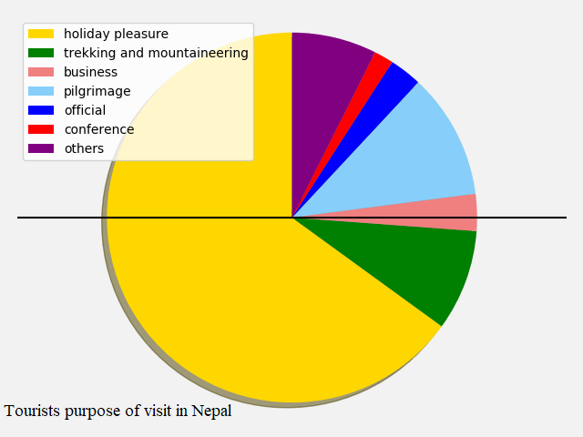
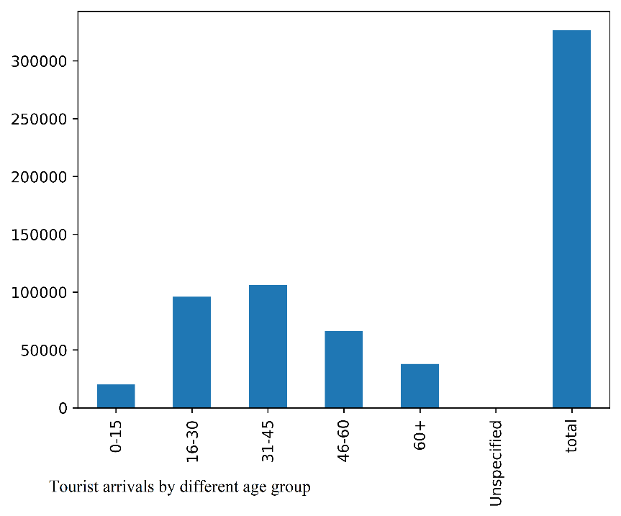
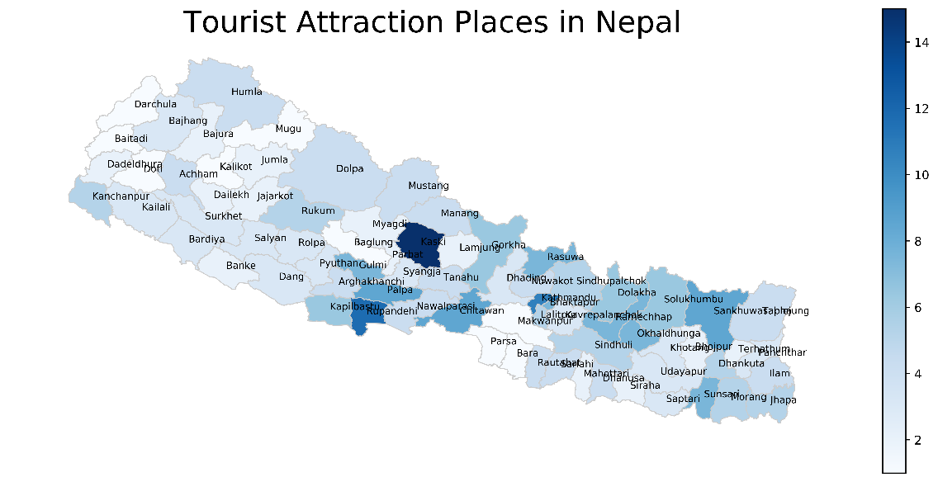
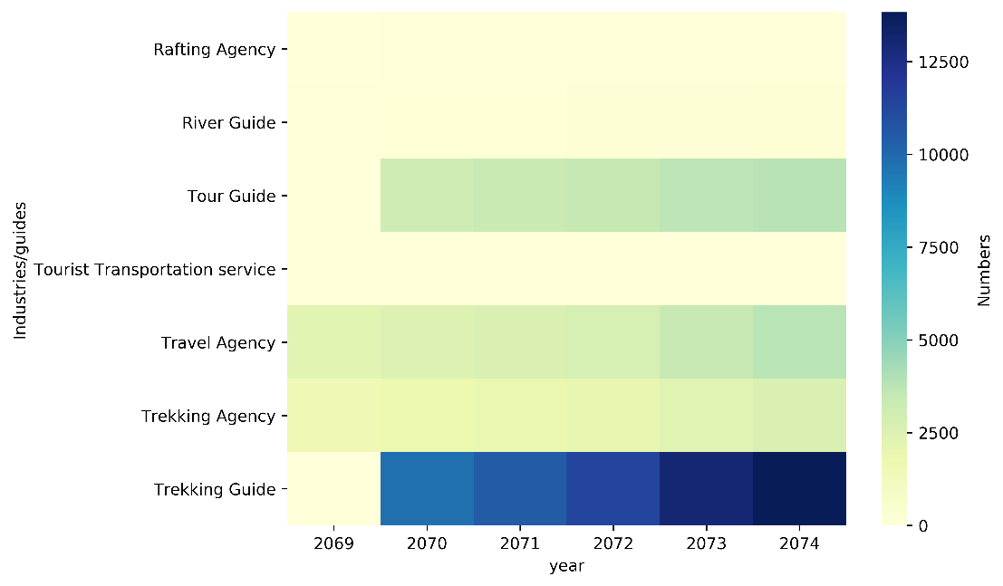
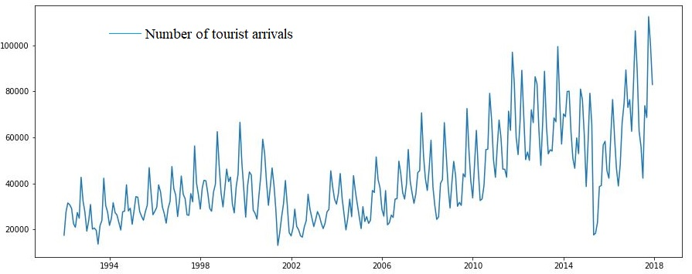
Some Visualizations

Slide 12
Simple Linear Regression Model
Dataset and Prediction Overview
Y=-4478336.394805195+2244.041558441558X
starting fiscal year (X) | Net received foreign exchange earning(NRs in million)(Y)
1996 | 8523
1997 | 9881.6
1998 | 12167.8
1999 | 12073.9
2000 | 11717
2001 | 8654.3
2002 | 11747.7
2003 | 18147.4
2004 | 10463.8
2005 | 9556
2006 | 10125.3
2007 | 18653.1
2008 | 27959.8
2009 | 28138.6
2010 | 24610.7
2011 | 30703.8
2012 | 34210.6
2013 | 46374.9
2014 | 53428.8
2015 | 41765.4
2016 | 58526.9
Year | Actual | Predicted
2012 | 34210.6 | 36675.221
2013 | 46374.9 | 38919.263
2014 | 53428.8 | 41163.303
2015 | 41765.4 | 43407.345
2016 | 58526.9 | 45651.3870
RMSE:8724.426
Year | Forecasted
2017 | 47895.429
2018 | 50139.470

Slide 13


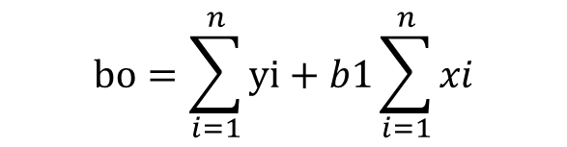
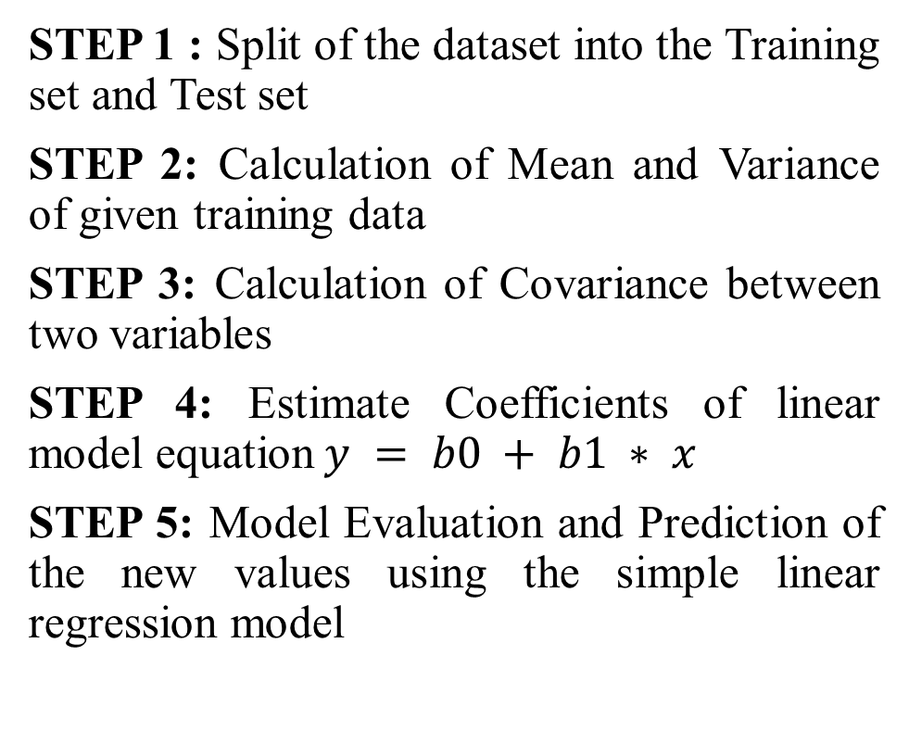

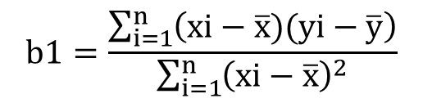
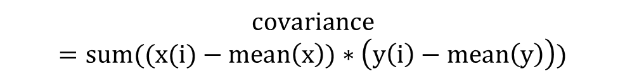

Model Implementation Steps
$$mean\left(x\right)=sum(x)/count(x)$$
$$variance={sum(x−mean\left(x\right))}^{2}$$
STEP 1 : Split of the dataset into the Training set and Test set
STEP 2: Calculation of Mean and Variance of given training data
STEP 3: Calculation of Covariance between two variables
STEP 4: Estimate Coefficients of linear model equation$y = b0 + b1 ∗ x$
STEP 5: Model Evaluation and Prediction of the new values using the simple linear regression model
$$covariance=sum((x(i)−mean\left(x\right))∗\left(y\left(i\right)−mean\left(y\right)\right))$$
$$b1=\frac{\sum_{i=1}^{n}{\left(xi−\overline{x})(yi−\overline{y}\right)}}{\sum_{i=1}^{n}{{\left(xi−\overline{x}\right)}^{2}}}$$
$$b1=covariance (x, y) / variance(x)$$
$$bo=\sum_{i=1}^{n}{yi+b1\sum_{i=1}^{n}{xi}}$$
$$b0 = mean(y) − b1 ∗ mean(x)$$
$$y = b0 + b1 ∗ x$$

Slide 14
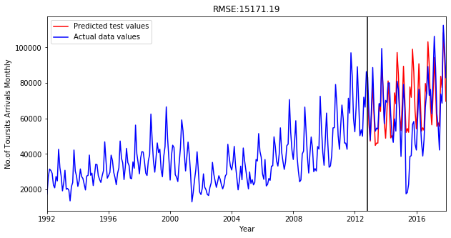
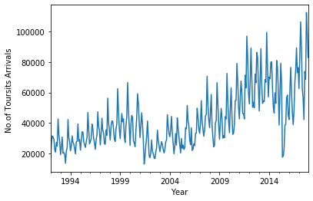
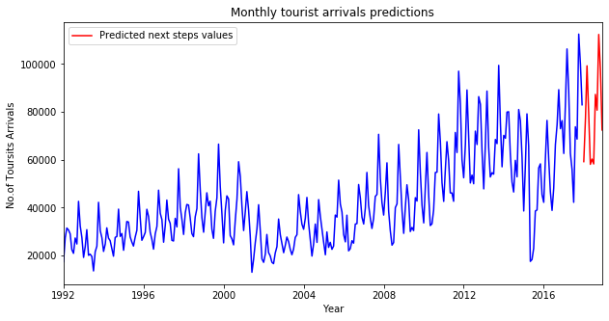
SARIMA(Seasonal Autoregressive Integrated Moving Average) Model
Dataset and prediction Overview
Month | No. of Tourists arrivals
1992-01 | 17451
1992-02 | 27489
1992-03 | 31505
1992-04 | 30682
1992-05 | 29089
1992-06 | 22469
1992-07 | 20942
1992-08 | 27338
1992-09 | 24839
1992-10 | 42647
1992-11 | 32341
1992-12 | 27561
………. | ……….
2017-12 | 82966
SARIMA(3,0,3)(2,1,0)[12]

Slide 15
SARIMA(Seasonal Autoregressive Integrated Moving Average ) Model
Notation:
SARIMA(p,d,q)(P,D,Q)[S]
Where p,d.q are respective order of AR ,MA and differencing of non seasonal ARIMA model
P is seasonal autoregressive(AR) order.
D is seasonal difference (I)order
Q is seasonal moving average (MA)order.
S is the number of time steps for a single seasonal period.

Slide 16

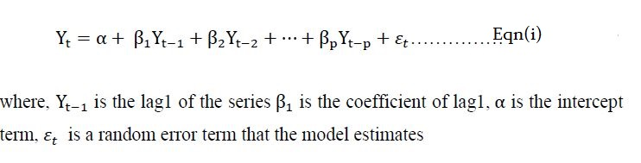
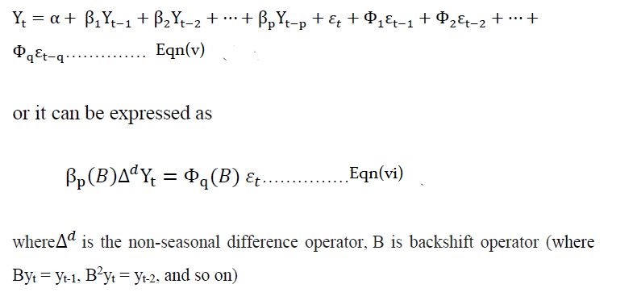
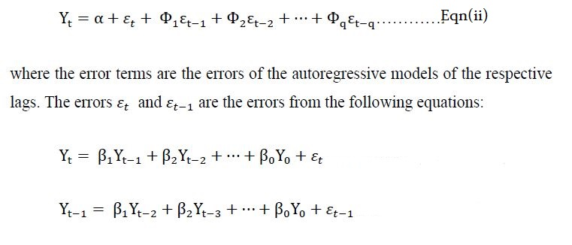
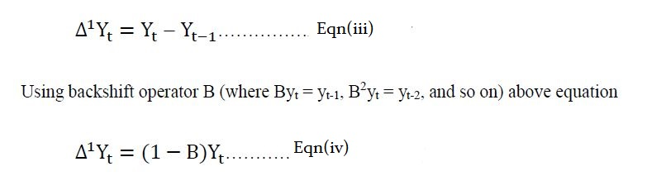
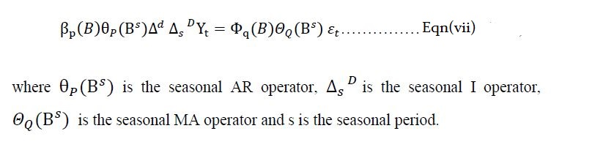
Autoregressive Part (AR Part)
Yt depends on some linear combination of previous observed values up to a defined maximum lag (denoted p), plus a random error term
ARIMA model Equation
ARIMA model in words:
Predicted Yt = Constant + Linear combination Lags of Y (up to p lags) + Linear Combination of Lagged forecast errors (up to q lags)
The integration part (I Part)
The process of differencing is known as integration part (I) and the order of differencing is denoted as d.
Seasonal ARIMA Equation
SARIMA allows for the presence of seasonality in a series
Its combination of non seasonal part ARIMA and seasonal part ARIMA
Moving Average Part (MA Part)
Yt is that the observed value is a random error term plus some linear combination of previous random error terms up to a defined maximum lag (denoted q).

Slide 17

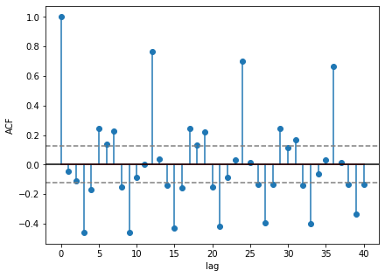
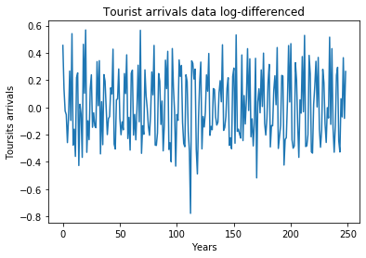
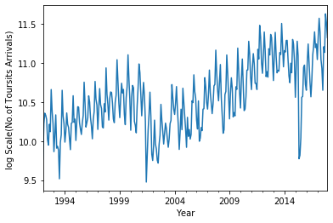

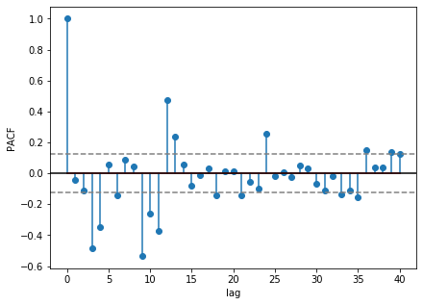

Model Implementation Steps
Identifying the order of differencing(d):
d=0 if the series has no visible trend /AFC at most lag low
d≥1 if the series has visible trend (from fig d=0)
Identifying the number of AR (p)and MA(q) terms
p is equal to the first lag where the PACF value is above the significance level. (from fig p=3)
q is equal to the first lag where the ACF value is above the significance level. (from fig q=3)
Identifying the seasonal part of the model(P,D,Q,S):
S is equal to the ACF lag with the highest value. (from fig S=12)
D=1 if the series has a stable seasonal pattern over time.(from fig D=1)
D=0 if the series has an unstable seasonal pattern over time.
P≥1 if the ACF is positive at lag S, else P=0.(from fig P=2)
Q≥1 if the ACF is negative at lag S, else Q=0.(from fig Q=0)
Observation and necessary transformation of time series data
Differencing of time series data
Split of the dataset into the Training set and Test set
Identification of non-seasonal and seasonal level model(SARIMA model)
Differencing formula
$${Δ^{1}Y}_{t}=Y_{t}−Y_{t−1}$$

Slide 18
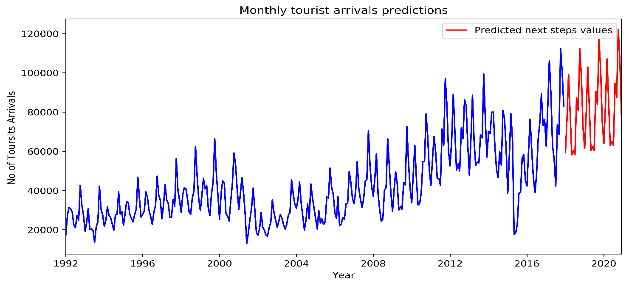
Contd..
5. Creating SARIMA model
SARIMA(3,0,3)(2,1,0)[12]
ie. p=3 , d=0 , q=3
P=2 , D=1 , Q=0 , S=12
6. Evaluations of the model and further predictions

Slide 19
Multilayer Perceptron(MLP) Model
Places | Year | Number of tourist attraction spots | Number tourist activities available | Main Purpose of visit | Accessibility status | Accomodation status | Health services status | %Tourist arrival
Dhulikhel | 2019 | 6 | 4 | Holiday/Pleasure | Better | Better | Good | 21.879255294799805
Helambu | 2019 | 4 | 3 | treeking | Good | Better | Fair | 1.0644960403442383
Gokyo Valley | 2019 | 4 | 3 | treeking | Good | Good | Fair | 0.13958019018173218
Taplejung | 2019 | 5 | 3 | Treeing&Mountaineering | Poor | Fair | Poor | 0.5248016119003296
Bandipur | 2019 | 4 | 4 | Holiday/Pleasure | Good | Good | Fair | 2.0926218032836914
Dataset and prediction Overview
Inputs(independent variables) | Output(dependent variable)
1.Year 2.Number of tourist attraction spots 3.Number tourist activities available 4.Main Purpose of visit 5.Accessibility status 6.Accomodation status 7.Health services status | 1.Percentage out of total tourist arrivals in that place

Slide 20
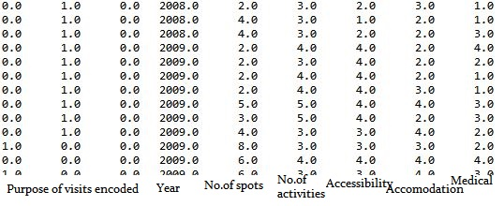
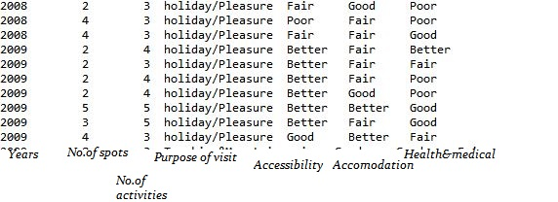
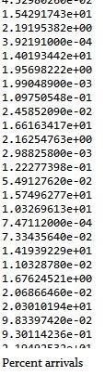
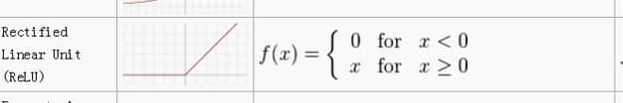
Model Implementation Steps
Import of the dataset and separation dependent and independent variables
Encoding and labeling the categorical data
Split of the dataset into the Training set and Test set
Creating regression model & Fitting the MLP model to the Training set
Evaluations of the model and further predictions
LAYERS | NUMBERS | ACTIVATION FUNCTION USED
Input layer | No.of inputs=9 | -None
Hidden layer | -No.of hidden layers=2 -No.of neurons or nodes in each layer=20 | -Rectifier linear unit function (Relu)
Output layer | No.of outputs=1 No.of output node=1 | -None
if input > 0:
return input
else:
return 0
Train sets(X_train and y_train) | Batch Size Used | Epochs
About 80 percent of total dataset | 10 | 300
MSE:(4-6)

Slide 21
Conclusion
The project activities were focused basically on data collection and preparations along with basic user interface design of the web application
Data collection and preparations tasks usually consumed more time as this required detail consideration of statistical reports and conversion and storage to suitable format before performing data analysis and predictions tasks
The user interface design also involved the understanding of what the application layout looks like and what functionalities should be there exactly in implementation of project goals

Slide 22
Limitation
The web application support only two-level role (i.e. Admin and Guest). There is no guest or user account and admin need to register to this system separately before actually using system
The analysis and predictions highly depend on the accuracy of data in the data sources. Also, the latest updates depend only on update made by the data source

Slide 23
Future Enhancement
Enable application to keep track of guest most visited pages, most downloaded contents
Enhance admin functionalities like creating other admin registrations, easy admin communications, application usage analytics etc.
Enhance API functionalities like extract latest data from direct data sources, keep track of API request, responses and report it to admin

Slide 24
REFERENCES
[1] World Travel & Tourism Council. The WTTC report: Travel and Tourism Economic Impact 2018 world [Accessed: 02-Jan-2019]
[2] World Travel & Tourism Council. The WTTC report: Travel and Tourism Economic Impact 2017 Nepal [Accessed: 02-Jan-2019]
[3] Ministry of Culture,Tourism & Civil Aviation,Nepal. [Online]. Available: http://tourism.gov.np/downloads. [Accessed: 02-Jan-2019]
[4] D. C. Frechtling, Forecasting Tourism Demand: Methods and Strategies, Oxford: Butterworth-Heinemann, 2001. [Accessed: 02-Jan-2019]
[5] Marine-Roig, E. & AntonClave, S. Tourism analytics with massive user generated content: A case study of Barcelona. Journal of Destination Marketing & Management (2015) [Accessed: 02-Jan-2019]
[6] Xiang, Zheng, and Daniel R. Fesenmaier. Analytics in Smart Tourism Design Concepts and Methods. Springer International Publishing, 2018. [Accessed: 02-Jan-2019]
[7] "Redirecting...",Analytics.google.com,2019.[Online].Available:https://analytics.google.com/analytics/web/. [Accessed: 02- Jan- 2019].
[8] "Destination Analysts | Tourism Market Research", Destination Analysts, 2019. [Online]. Available: http://www.destinationanalysts.com/. [Accessed: 02- Jan- 2019].

Slide 25
[9] Shumway R.H., Stoffer D.S. (2000) Time Series Regression and ARIMA Models. In: Time Series Analysis and Its Applications. Springer Texts in Statistics. Springer, New York, NY [Accessed: 02-Jan-2019]
[10] Makridakis S, Spiliotis E, Assimakopoulos V (2018) Statistical and Machine Learning forecasting methods: Concerns and ways forward. PLoS ONE 13(3): e0194889. https://doi.org/10.1371/journal.pone.0194889 [Accessed: 02-Jan-2019]
[11] Subedi, A. (2017). Time series modeling on monthly data of tourist arrivals in Nepal: An alternative approach. Nep. J. Stat., 1, 41-54[Accessed: 02-Jan-2019]
[12] Roman Josue de las Heras Torres, “7 Ways Time Series Forecasting Differs from Machine Learning,” Oracle DataScience.com. [Online]. Available: https://www.datascience.com/blog/time-series-forecasting-machine-learning-differences. [Accessed: 02-Jan-2019].
[13] Dorffner, G. 1996, Neural Networks for Time Series Processing. Neural Network World [Accessed: 02-Jan-2019]
[14] N. K. Ahmed, A. F. Atiya, N. E. Gayar, and H. El-Shishiny. An empirical comparison of machine learning models for time series forecasting. Econometric Reviews, 29(5-6):594, 2010. [Accessed: 02-Jan-2019]
[15] Voyant, Cyril & Nivet, Marie-Laure & Paoli, Christophe & Muselli, Marc & Notton, G. (2014). Meteorological time series forecasting based on MLP modelling using heterogeneous transfer functions. [Accessed: 02-Jan-2019]
[16] C. Pelletier, A. Almalaq, and D. M. de Lachapelle, “Deep Learning for Time Series Forecasting,” Machine Learning Mastery. [Online]. Available: https://machinelearningmastery.com/deep-learning-for-time-series-forecasting. [Accessed: 02-Jan-2019].
[17] Civil Aviation Authority of Nepal. [Online]. Available: http://caanepal.gov.np/. [Accessed: 02-Jan-2019].
[18] Raschka, Sebastian. Python Machine Learning. Packt, 2015. [Accessed: 02-Jan-2019]

Slide 26
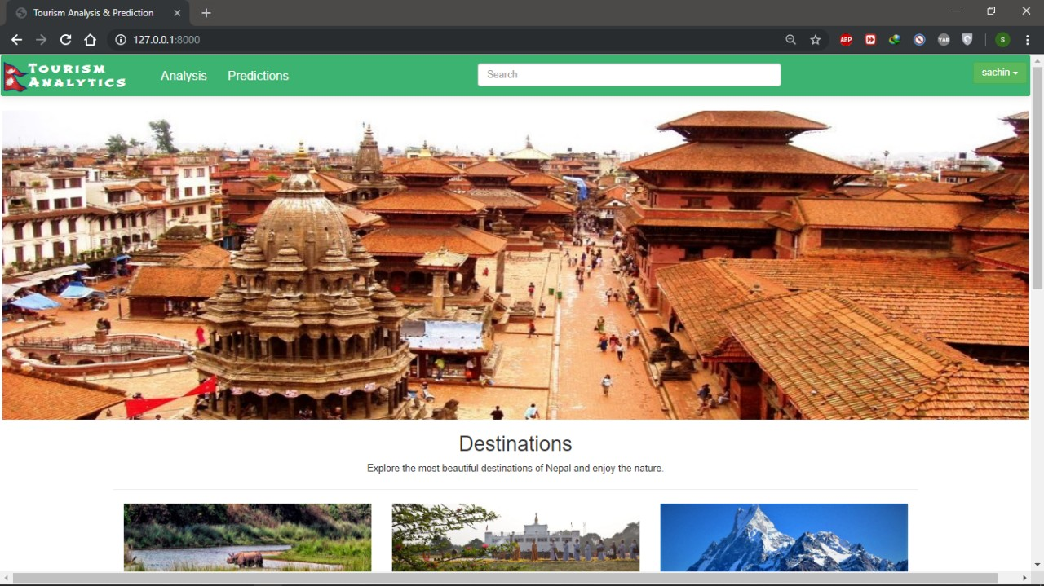
Snapshot

Slide 27
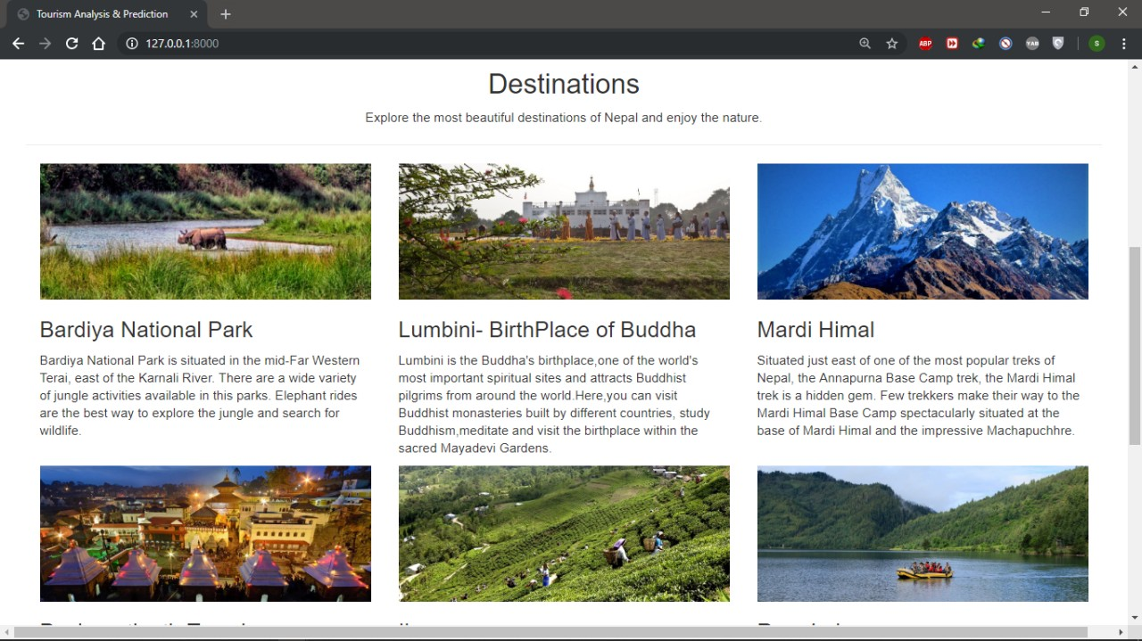

Slide 28
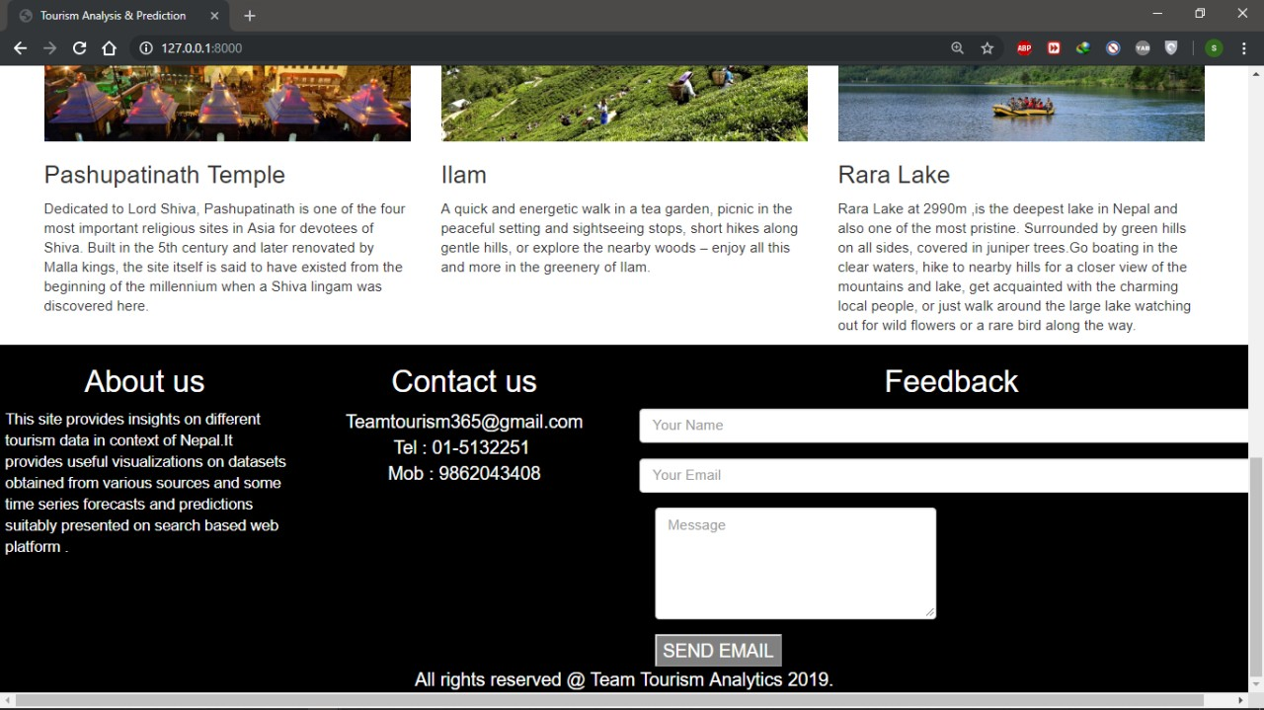

Slide 29
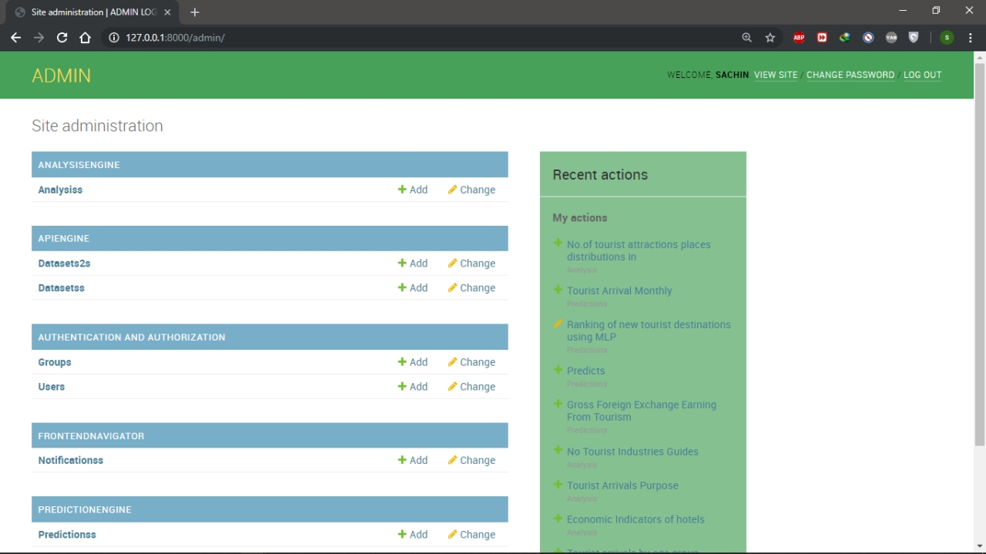

Slide 30
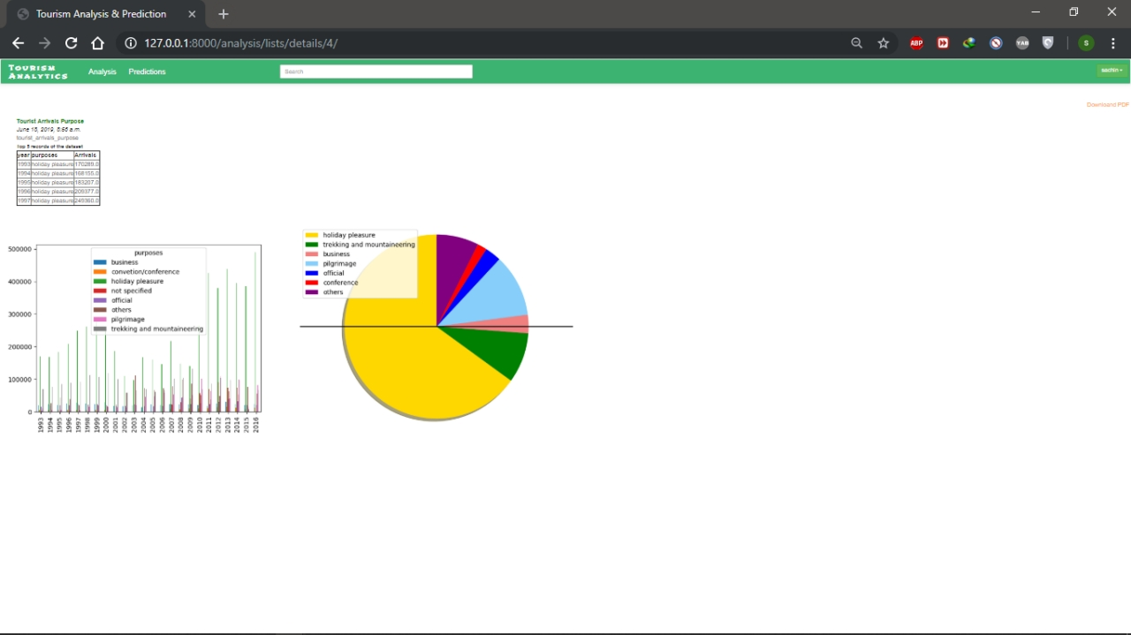

Slide 31
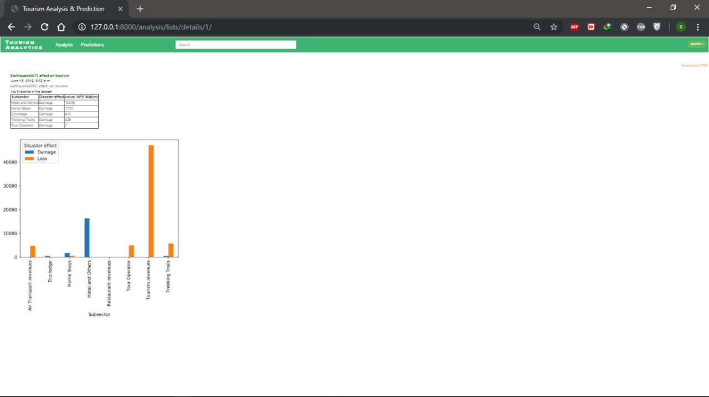

Slide 32
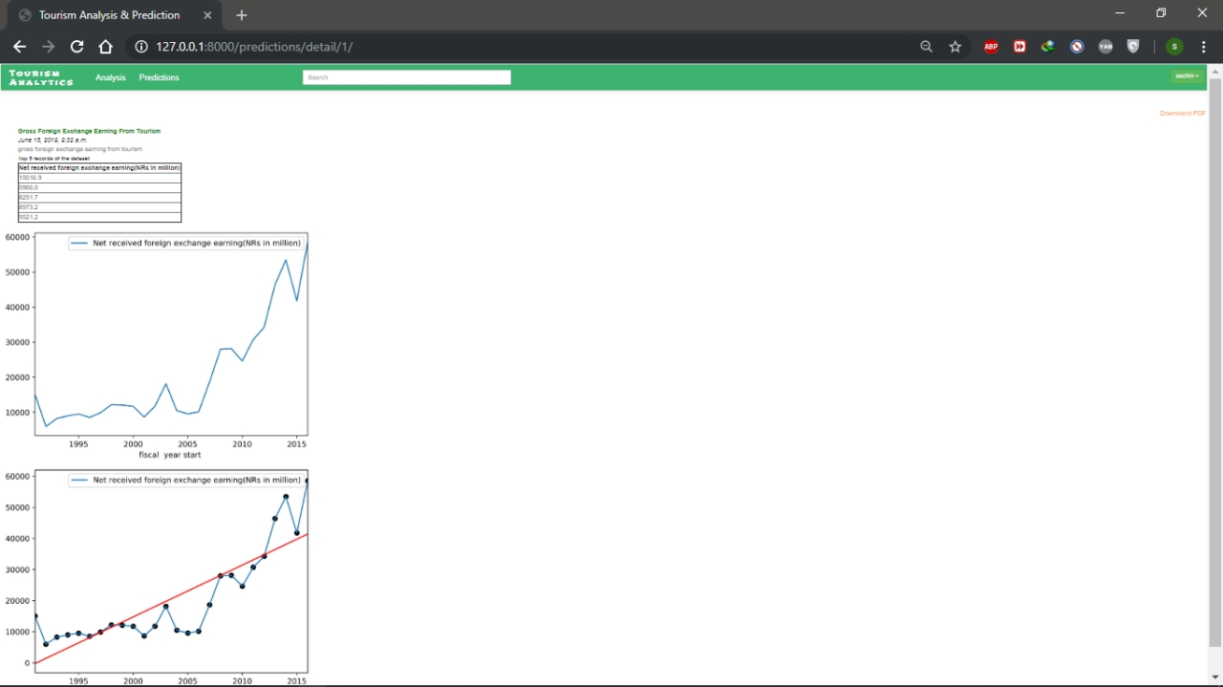

Slide 33
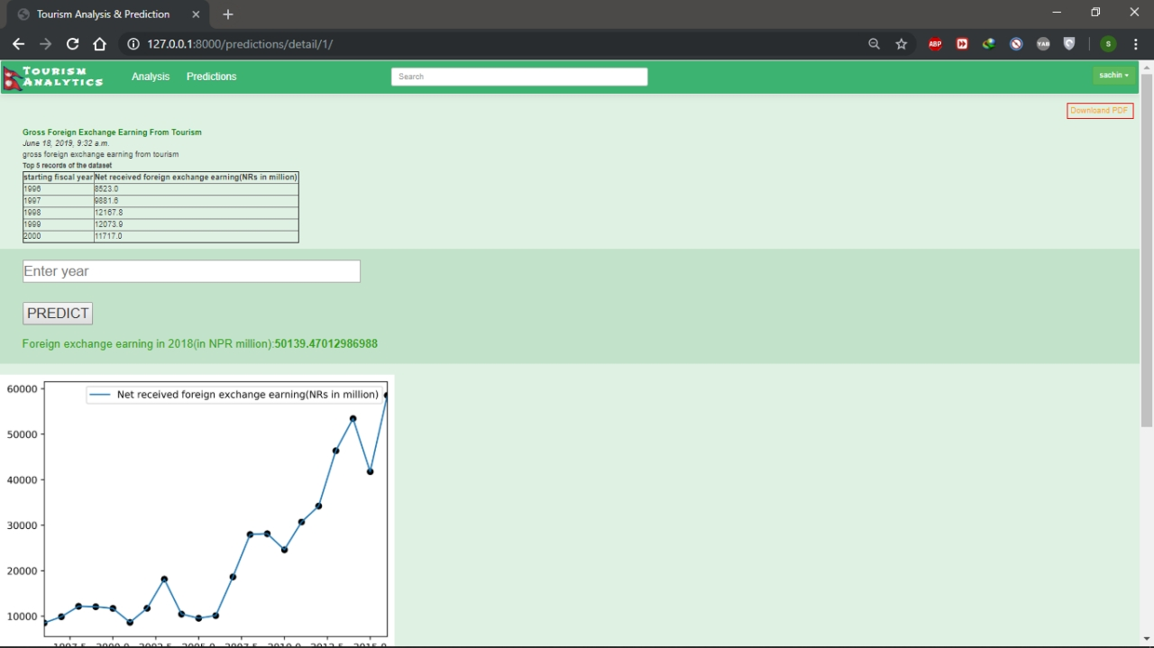

Slide 34
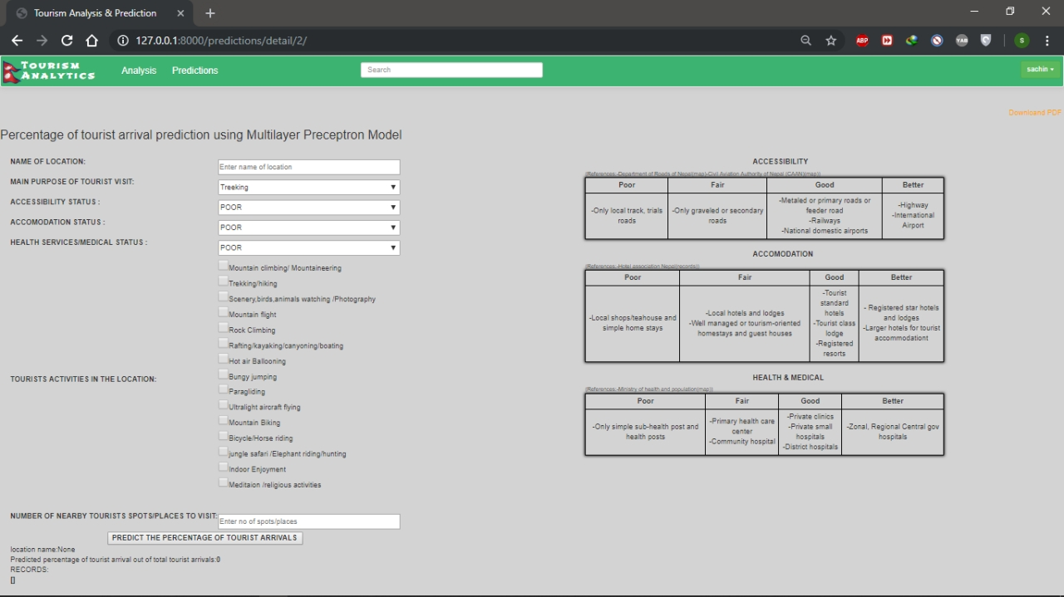

Slide 35
